Slide 1
Lecture 6
Divide-and-Conquer

Slide 2
Divide-and-Conquer
The most-well known algorithm design strategy:
Divide instance of problem into two or more smaller instances
Solve smaller instances recursively
Obtain solution to original (larger) instance by combining these solutions

Slide 3
Divide-and-Conquer Technique (cont.)
a problem of size n
subproblem 1
of size n/2
subproblem 2
of size n/2
a solution to
subproblem 1
a solution to
subproblem 2
a solution to
the original problem
It general leads to a recursive algorithm!

Slide 4
Divide-and-Conquer Examples
Sorting: mergesort and quicksort
Binary search
Closest-pair
Binary tree traversals
Multiplication of large integers
Matrix multiplication: Strassen’s algorithm
Convex-hull algorithms
And more

Slide 5
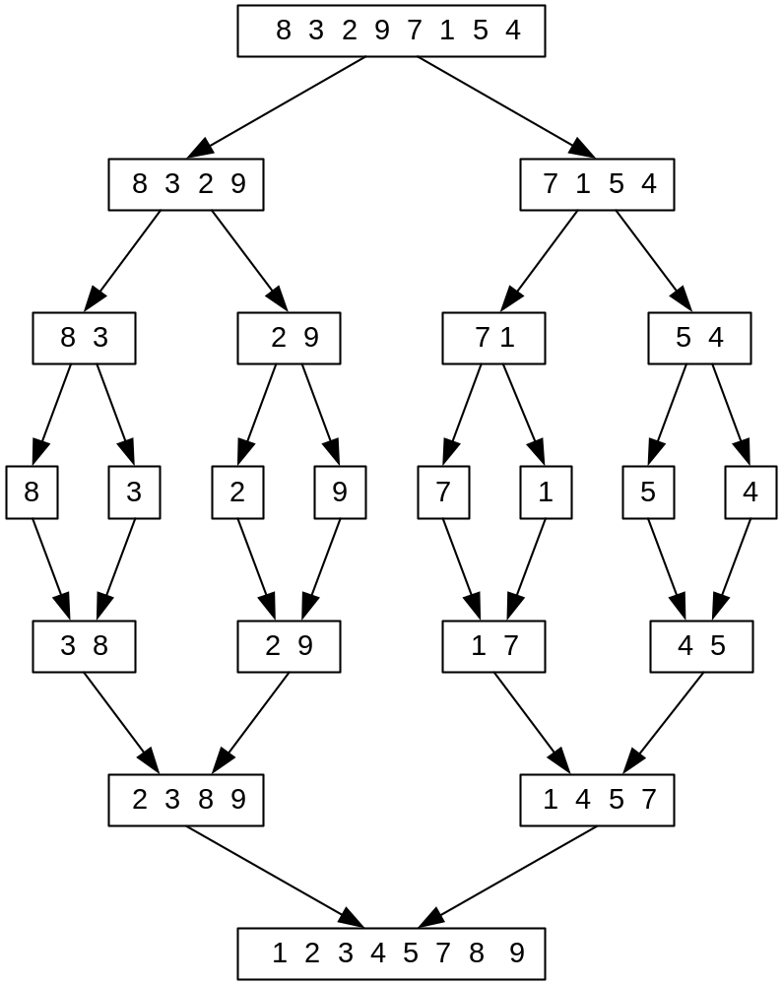
Mergesort Example
Notes:
Go over this example in detail, then do another example of merging, something like:
(1 2 5 7 9)
(3 4 6)

Slide 6
Analysis of Mergesort
All cases have same efficiency: Θ(n log n)
If the data is represented using a dynamic array, the temporary array created in the divide stage will be allocated and de-allocated several times, this attitude consumes a lot of time.
To overcome this problem and to enhance the performance in practice, use another sorting algorithm (e.g. insertion sort) when the size of the divided array reach a specific size, (say 50)
This will eliminate the number of memory allocations and de-allocations, as sorting 50 elements take no time (very small time) using any of the sorting algorithms
T(n) = 2T(n/2) + Θ(n), T(1) = 0
Notes:
even if not analyzing in detail, show the recurrence for mergesort in worst case:
T(n) = 2 T(n/2) + (n-1)
worst case comparisons for merge

Slide 7
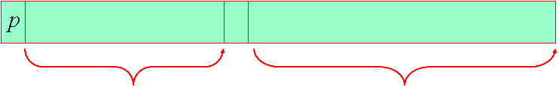
Quicksort
Select a pivot (partitioning element) – here, the first element
Rearrange the list so that all the elements in the first s positions are smaller than or equal to the pivot and all the elements in the remaining n-s positions are larger than or equal to the pivot (see next slide for an algorithm)
The pivot is now in its final position
Sort the two subarrays recursively
A[i]≤p
A[i]>p

Slide 8
Quicksort algorithm
Function quicksort(array) {
  Temparray less, greater
  if length(array) ≤ 1
  return array
  select and remove a pivot value pivot from array
  for each x in array
    if x ≤ pivot then
    append x to less
    else
    append x to greater
  return concatenate(quicksort(less), pivot, quicksort(greater))
}

Slide 9
Quicksort Example
5 3 1 9 8 2 4 7
Less
Pivot
greater
3 | 1 | 2 | 4
5
9 | 8 | 7
1 | 2
3
4
8 | 7
9
1
2
7
8
1 | 2 | 3 | 4 | 5 | 7 | 8 | 9

Slide 10
Analysis of Quicksort
Best case: split in the middle — O(n log n)
Even if the split was 9 to 1 still O(n log n)
Worst case: sorted array! — O(n²)
Average case: random arrays — O(n log n)
Improvements:
  better pivot selection: median of three partitioning
  switch to insertion sort on small subfiles
  elimination of recursion
  These combine to 20-25% improvement
Considered the method of choice for internal sorting of large files (n ≥ 10000)
T(n) = 9T(n/10) + T(n/10) + n
T(n) = T(n-1) + O(n)

Slide 11
Binary Search
Very efficient algorithm for searching in sorted array:
K
vs
A[0] . . . A[m] . . . A[n-1]
If K = A[m], stop (successful search); otherwise, continue
searching by the same method in A[0..m-1] if K < A[m]
and in A[m+1..n-1] if K > A[m]
l ← 0; r ← n-1
while l ≤ r do
m ← ⎣(l+r)/2⎦
if K = A[m] return m
else if K < A[m] r ← m-1
else l ← m+1
return -1

Slide 12
Analysis of Binary Search
Time efficiency
  worst-case recurrence: T (n) = 1 + T( n/2 ), T (1) = 1
  solution: T(n) =log₂(n) prove it?
  This is VERY fast: e.g., T(10⁶) = lg(1000000)=19.9
Optimal for searching a sorted array
Limitations: must be a sorted array (not linked list)
Same principle in BST.

Slide 13
Closest-Pair Problem
given n points in metric space, find a pair of points with the smallest distance between them
A brute force algorithm can easily be computed in O(n²) time. To do that, one could compute the distances between all the n(n − 1) / 2 pairs of points, then pick the pair with the smallest distance, as illustrated below.
minDist = infinity
for each p in P:
for each q in P:
if p ≠ q and dist(p, q) < minDist:
minDist = dist(p, q)
closestPair = (p, q)
return closestPair

Slide 14
Closest-Pair Problem by Divide-and-Conquer
Divide : into two subsets (according to x-coordinate)
Conquer: recursively on each half.
Combine: select closer pair of the above.
One point from the left half and the other from the right
may have closer distance!

Slide 15
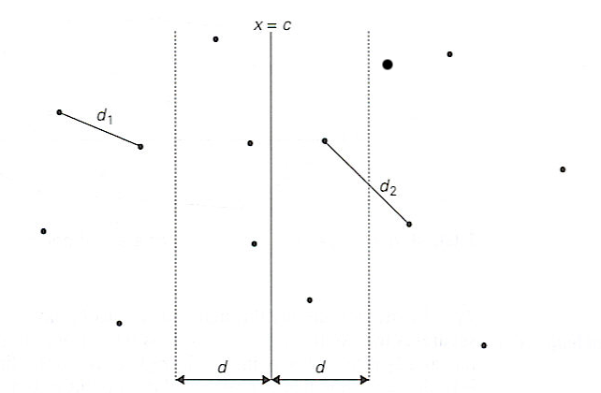
Closest-Pair Problem by Divide-and-Conquer
Step 0 Sort the points by x (list one) and then by y (list two).
Step 1 Divide the points given into two subsets S₁ and S₂ by a vertical line x = c so that half the points lie to the left or on the line and half the points lie to the right or on the line.

Slide 16
Closest Pair by Divide-and-Conquer (cont.)
Step 2 Find recursively the closest pairs for the left and right
subsets.
Step 3 Set d = min{d₁, d₂}
We can limit our attention to the points in the symmetric
vertical strip of width 2d as possible closest pair. Let C₁
and C₂ be the subsets of points in the left subset S₁ and of
the right subset S₂, respectively, that lie in this vertical
strip. The points in C₁ and C₂ are stored in increasing
order of their y coordinates, taken from the second list.
Step 4 For every point P(x,y) in C₁, we inspect points in
C₂ that may be closer to P than d. There can be no more
than 6 such points (because d ≤ d₂)!
Notes:
Unfortunately, d is not necessarily the smallest distance between all pairs of points in S1 and
S2 because a closer pair of points can lie on the opposite sides separating the line. When we
combine the two sets, we must examine such points. (Illustrate this on the diagram)

Slide 17
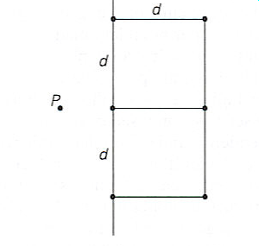
Closest Pair by Divide-and-Conquer: Worst Case
The worst case scenario is depicted below:

Slide 18
Efficiency of the Closest-Pair Algorithm
Running time of the algorithm (without sorting) is:
T(n) = 2T(n/2) + M(n), where M(n) ∈ Θ(n)
By the iteration method :
T(n) ∈ Θ(n log n)
So the total time is Θ(n log n).

Slide 19
Homework
Program and apply the enhanced Mergesort-insertion algorithm and the Quicksort algorithm using the same parameters in the first homework, and compare the results with the previous sorting algorithms.
Program and apply the sequential searching algorithm and compare it with binary searching algorithm.
* search for (your last 3 digits *500) each time
* the 1st size of the searched array should be = your last 5 digits, then multiply by 2 and record the consumed time for each run.

